Slide 1
Java Virtual Machine

Slide 2
JVM
JVM (Java Virtual Machine) is an abstract machine. It is a specification that provides runtime environment in which java bytecode can be executed.
Runtime Instance Whenever you write java command on the command prompt to run the java class, an instance of JVM is created.

Slide 3
JVM
The JVM performs following operation:
Loads code
Verifies code
Executes code
Provides runtime environment
JVM provides definitions for the:
Memory area
Class file format
Register set
Garbage-collected heap
Fatal error reporting etc.

Slide 4
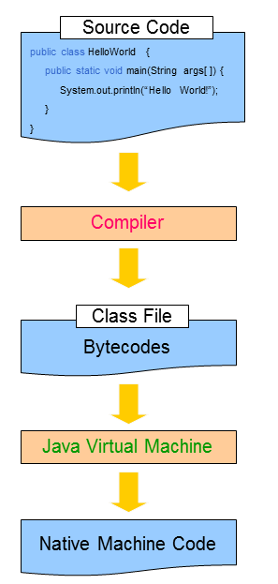
How does JVM work?
A Java program is written
The program is compiled
A class file is produced containing bytecodes
The bytecodes are interpreted by the JVM
The JVM translates bytecodes into native machine code

Slide 5
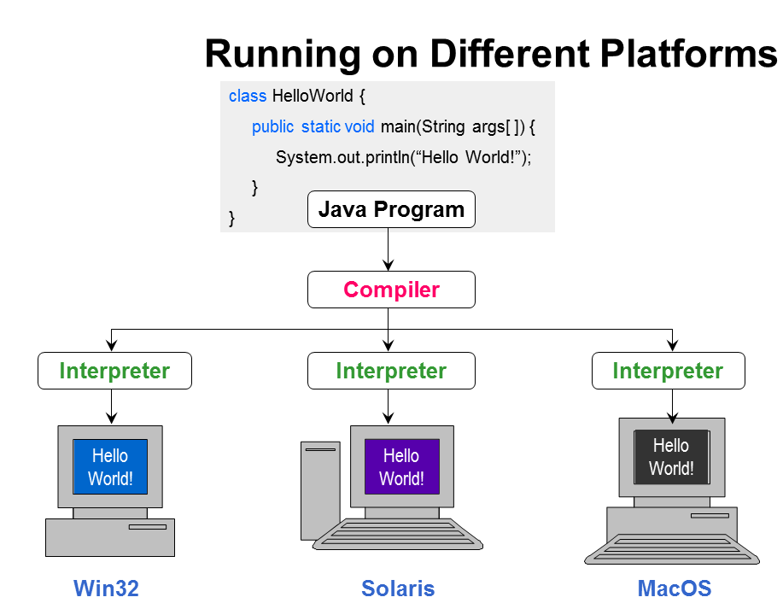
Running of different Platforms

Slide 6
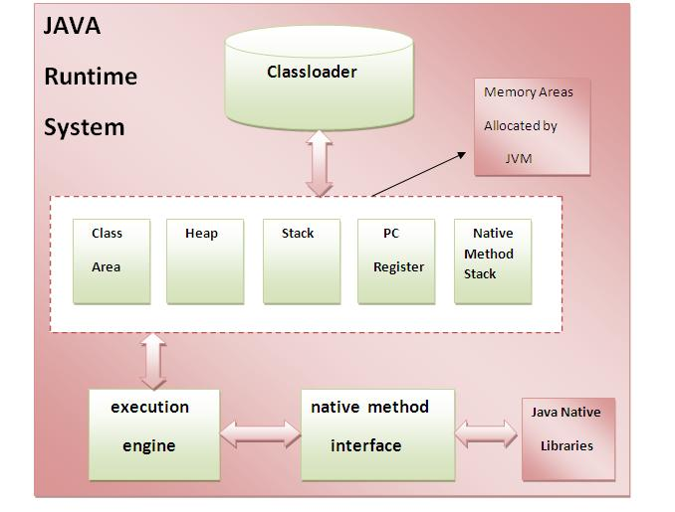
JVM Architecture

